Slide 1
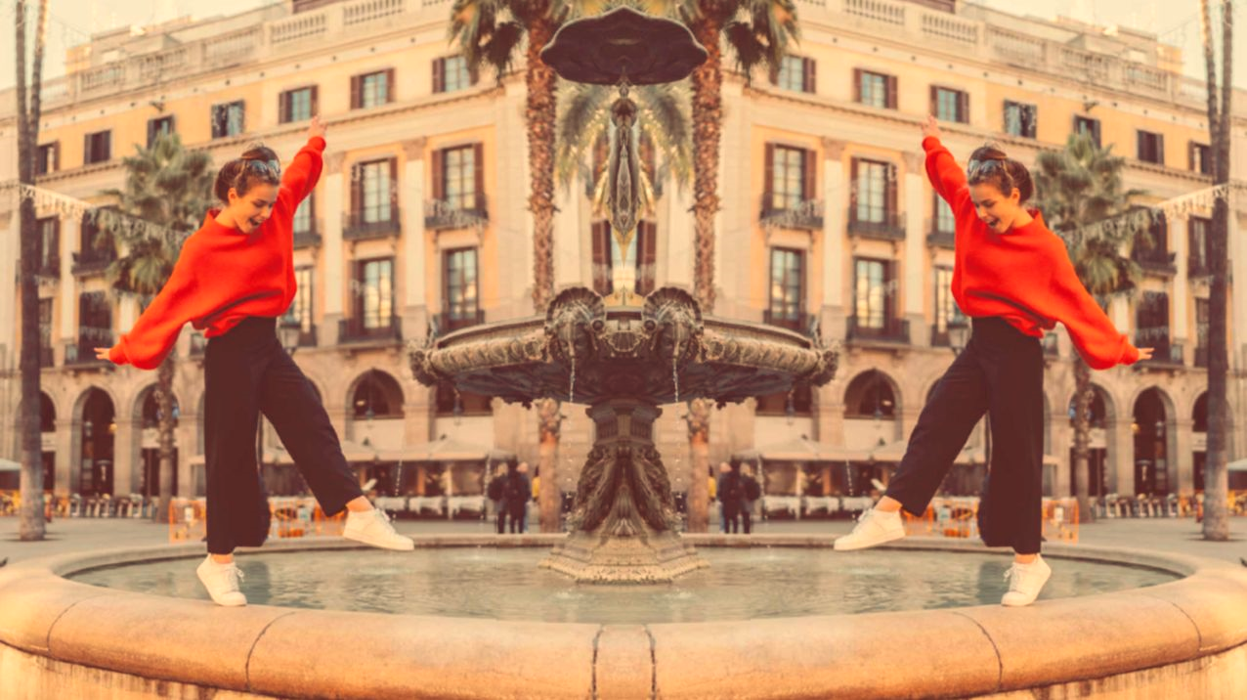
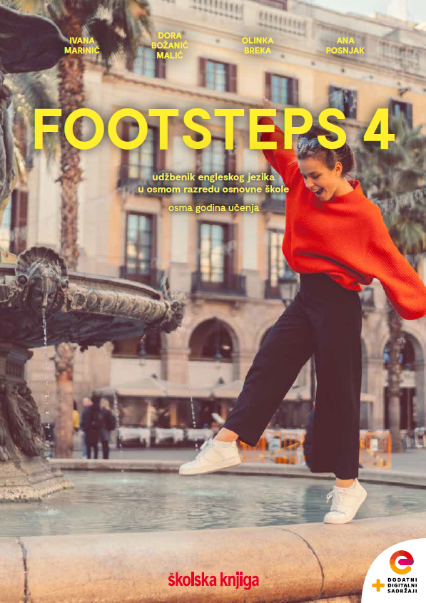

UNIT 3; Trends
Lesson 1; What to buy?

Slide 2
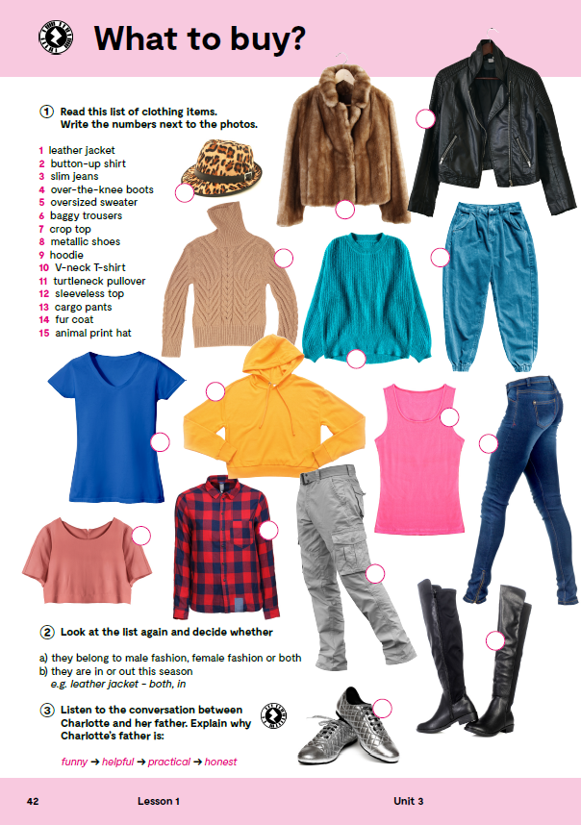
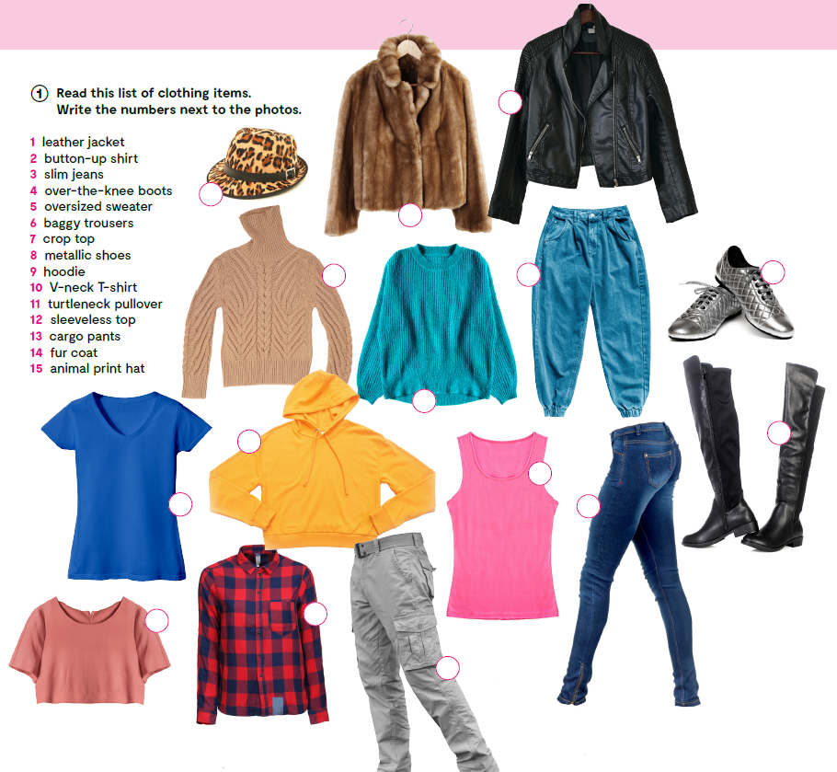
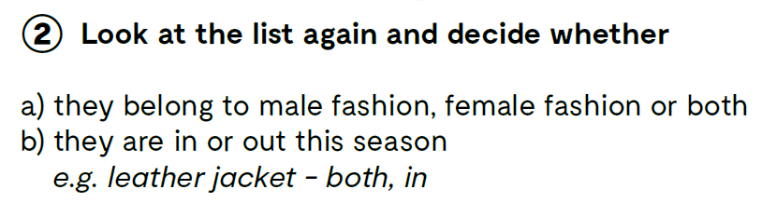
Do you know the meaning of these expressions?
1
na zakopčavanje
preko/iznad koljena
vrećaste/široke hlače
V izrez oko vrata
dolčevita
bez rukava
krzneni kaput
button-up
over-the-knee
baggy trousers
V-neck
turtleneck
sleeveless
fur coat
15
14
11
6
8
What do you think which one of these clothing items belongs to female fashion?
What about male fashion?
Which ones are worn by both women and men?
Are they IN or OUT this season?
Check what you have learnt. https://wordwall.net/play/12707/106/172
5
9
4
12
10
3
7
2
13

Slide 3
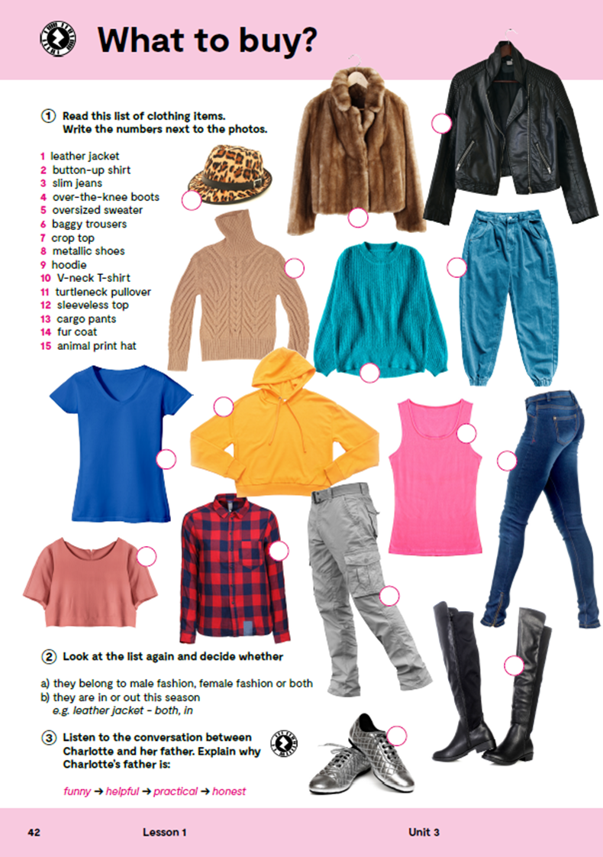

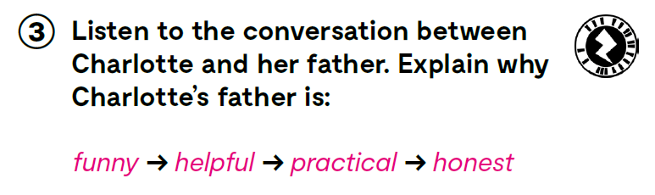
Listen to the conversation between Charlotte and her father. Explain why Charlotte’s father is: funny → helpful → practical → honest https://www.e-sfera.hr/dodatni-digitalni-sadrzaji/c1788295-b351-4119-914a-1a4b0da1c66f/assets/audio/09_unit_3__lesson_1__exercises_3_4.mp3

Slide 4
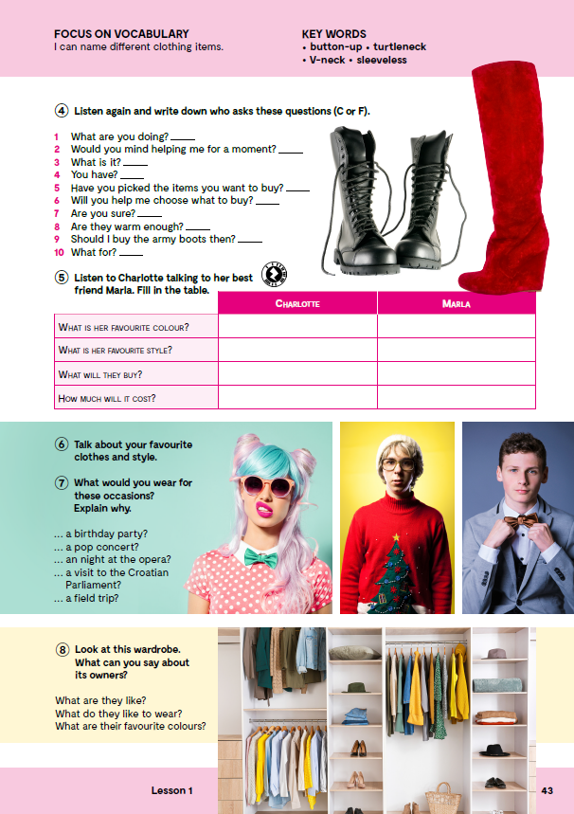
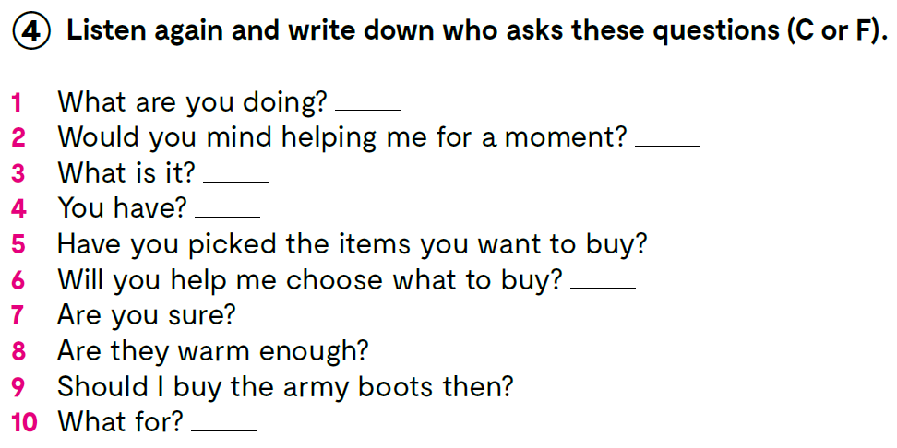
Listen again. https://www.e-sfera.hr/dodatni-digitalni-sadrzaji/c1788295-b351-4119-914a-1a4b0da1c66f/assets/audio/09_unit_3__lesson_1__exercises_3_4.mp3
C
C
F
F
F
C
F
F
C
F

Slide 5
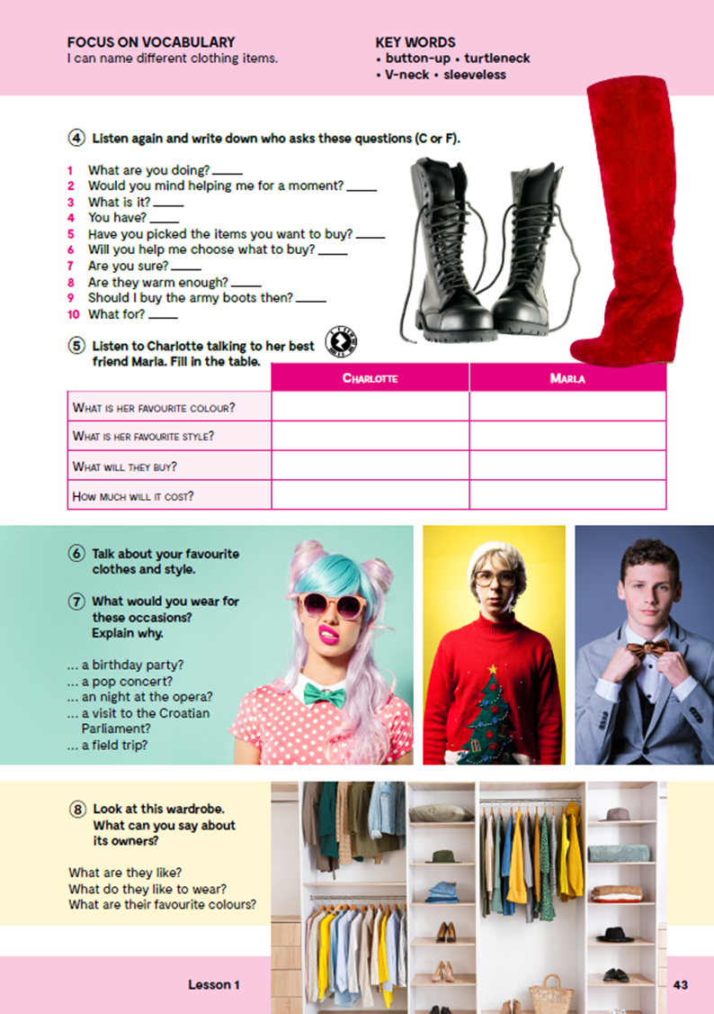
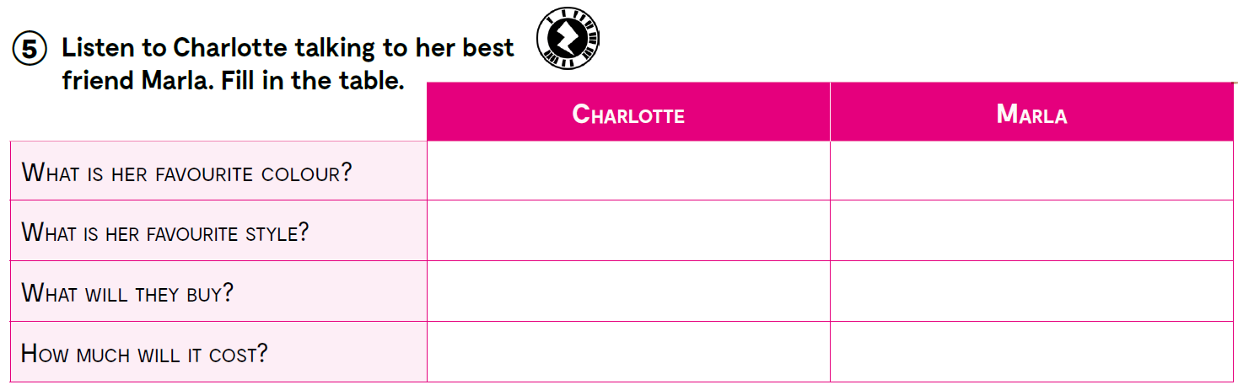
https://www.e-sfera.hr/dodatni-digitalni-sadrzaji/c1788295-b351-4119-914a-1a4b0da1c66f/assets/audio/10_unit_3__lesson_1__exercises_6.mp3
red
white
grunge
sporty
army boots
white hoodie
less than ₤40
₤5

Slide 6
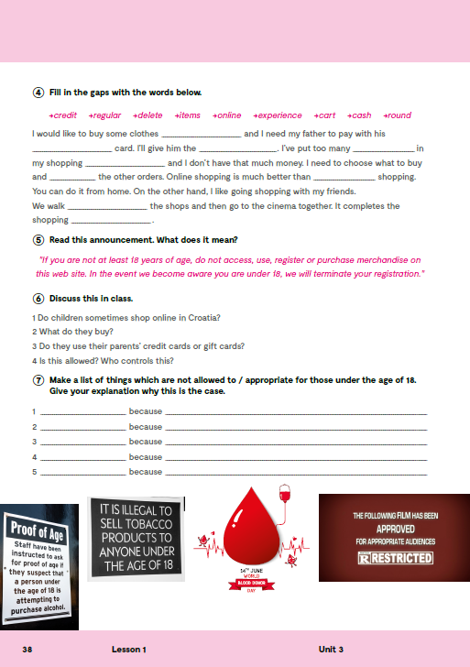
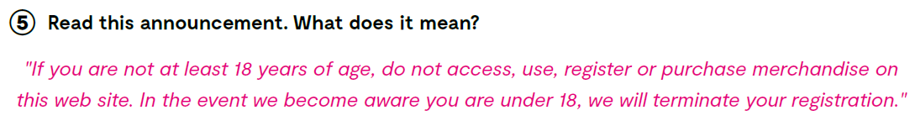
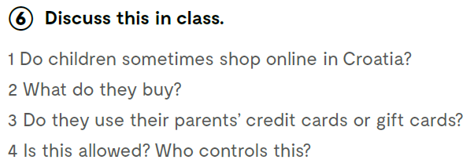

Slide 7

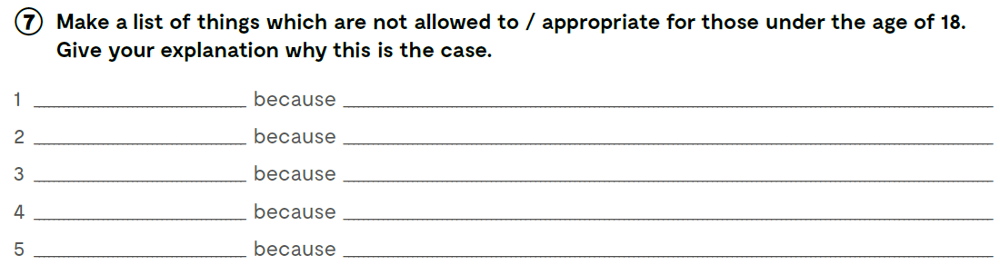

Slide 8
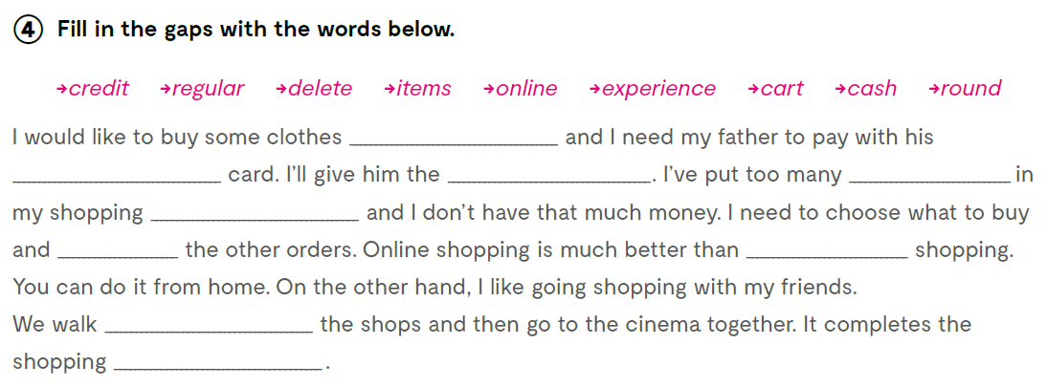
online
credit
cash
items
cart
delete
regular
round
experience

Slide 9
Describe the given item of clothing.
For example: hoodie = warm and cosy sweater with a hood. Boys and girls like to wear it very much. Everybody has one. It is always IN.
leather jacket ________________________________________________________
jeans _______________________________________________________
button-up shirt ________________________________________________________
crop top ________________________________________________________
army boots ________________________________________________________

Slide 10

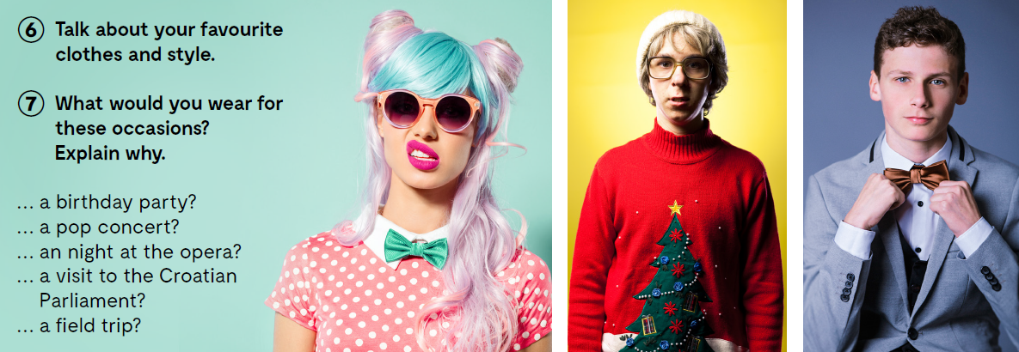
Think about your favourite clothes and style.
What would you wear for these occasions?

Slide 11

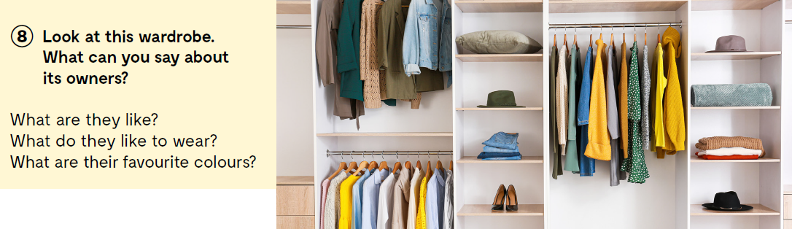

Slide 12

Open the following link and then click on LEARN MORE! https://www.e-sfera.hr/dodatni-digitalni-sadrzaji/c1788295-b351-4119-914a-1a4b0da1c66f/
Weird fashion in European history
Here are several strange fashion ideas from history: bliauts, bombasts, chopines, crakowes, crinolines, hobble skirts, paper dresses, and powdered wigs. What do you think they were? Read the texts and find out what are bliauts, bombasts, chopines, crakowes, crinolines, hobble skirts, paper dresses, and powdered wigs
Do the tasks bellow the text.

Slide 13
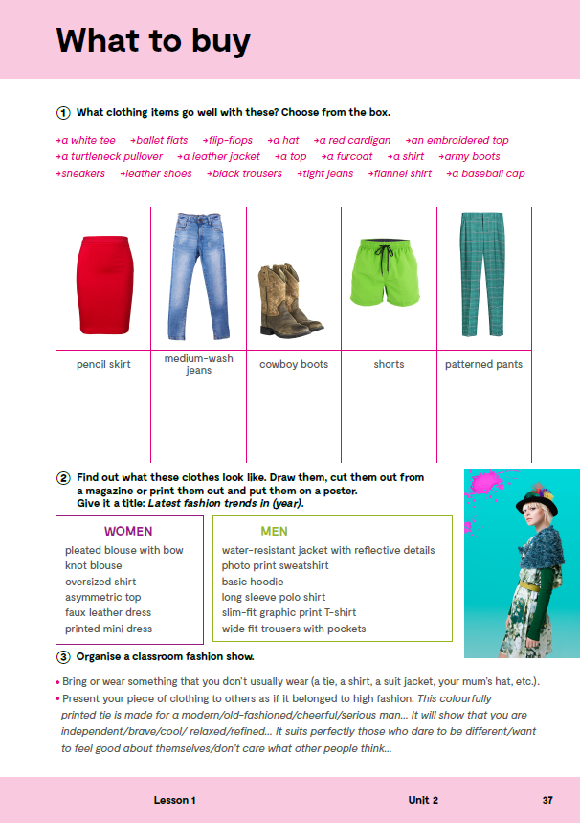
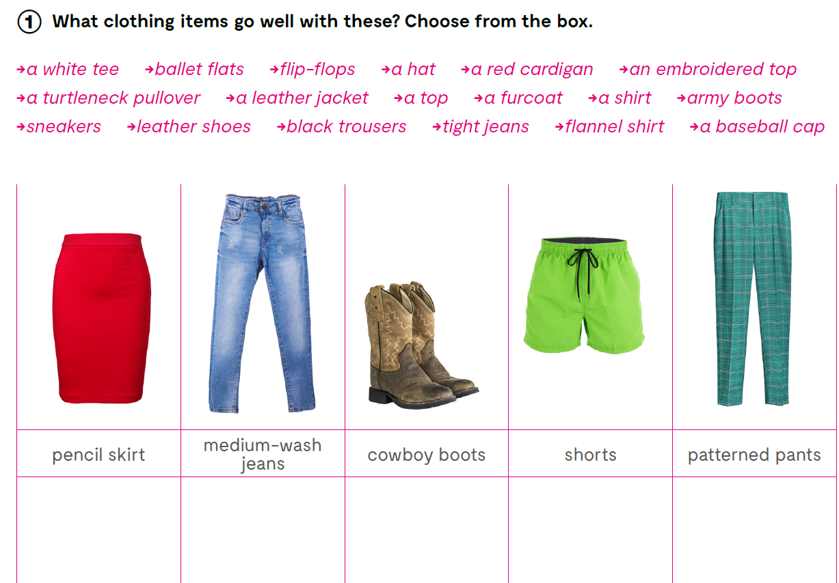

Slide 14

